Slide 1
Considerations for STJ Array Designs
Goals:
• 128-pixel STJ arrays (number matched to the maximum of four 32-channel XIA preamps)
• Pixels will be “small” (70 µm)² with highest resolution for sterile neutrino search, “medium”
(130 µm)² for EXASF (and neutrinos?) and “large” (200 µm)² for largest area at synchrotron.
• EXAFS STJs will have a ~1 µm Pb (or Ta?) absorber on top, neutrino STJs will not.
(Standard) Considerations:
• Pixels will be rotated by 45˚ on chip to facilitate suppression of dc Josephson current.
• Bond pads are 200 x 300 µm² with 250 µm pitch. Wires are 10 µm wide with 15 µm pitch.
• Bond pads made from STJ (base?) layer, with 300 nm of Au on top (use thin Ti underlayer).
• Pattern base layer first, then etch through top electrode and barrier with a timed etch.
• Use same top electrode mask / photoresist pattern for anodization to passivate the junction edges.
(New) Considerations:
• 200 µm Si wafers make backside etching relatively easy
• To prevent qp diffusion into the leads, leads must have a larger energy gap than the STJ.
• Al base electrode layer forms base wiring. Since Nb is easier to deposit than Ta, we will use Nb leads.
• We will not deposit an Au layer over most of the wafer to absorb and thermalize high-energy
phonons generated by interactions in the Si substrate, because Au does not stick well to Si₃N₄ and
SiO₂ does not like to stick to Au (need adhesion layer like Ti). Also, large area Au films will have stress
and associated delamination problems, and Robin is worried about wiring continuity at steps.
• Instead, we will use the same film as the Al base electrode for themalization. (Can we put Au on top?)
• Test chips no longer need 25 µm and a 284 µm STJs. (Sizes of 5 test STJs TBD.)
Notes:
Changes Possible between ADR and Dil Fridge
- Rotation of pixels?
Questions
- Wafers need to be DSP?
- QP Diffusion?

Slide 2
Proposed STJ Dimensions
Al-STJ
Anodization
Nb wiring
1µm SiN
15 µm
Si bars
200µm Si
≥50µm
10µm
5µm
Considerations:
• ≥50 µm wide “bars” between
membranes can be made reliably.
• 5 µm overlap or spacing between
structures can be made reliably.
• Leave Al base as phonon absorber
over most of wafer. (Put Au on top?)
• Anodization of junction edges serves
as insulator to avoid shorts from Nb
I don’t think any of the dimensions are critical, and they are chosen (at least initially) for reliability.
STJ dimensions
differ based on application
Nb
wiring
Al thermalizer
(same film as Al base)

Slide 3
Proposed Layout of 8 x 1 STJ Array Module
Al
Signals Ground
Al
STJ
60 µm
STJ
Al
SiN
10µm
15µm
Si bar
STJ + 30µm
50 µm
• Robin suggests 1 STJ per membrane for improved stability.
• Linear sub-arrays simplify wiring layout for large arrays.
• 8 pixels share one ground wire, i.e. 32 pixels will require 36 wires.
64 pixels can be read out with a single 78-pin loom and connector.
• Nb wires can be routed between Al thermalizers.
• Pixel spacing of (STJ+80 µm) within 8 x 1 array module is set by 50 µm
width of Si bar and 2 x 15 µm space between Si bar and STJ.
• Module spacing of (STJ width +210 µm) is set by (8+1)x 15µm wiring
pitch plus (say) 25 µm minimum width of Al thermalizer. Modules
with 70 (130, 200) µm pixels will have 280 (340, 410) µm pitch.
• All base layers must be electrically connected for anodization.
Check how this affects the mask layout for the leads.
Signal wires of next array module
STJ+80µm
140 µm
40 µm
STJ + 30µm
Notes:
200um Al, 300um Gold

Slide 4

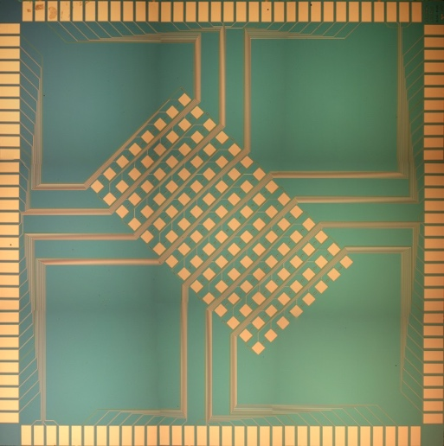
9 mm
1…
…36
9 + 9 + 9 + 9 wires
37
STJ+210µm
pitch
Considerations:
• 72 wires use 1 loom
+78-pin D-connector
• 200 µm x 300 µm
bond pads
• 250 µm pitch x 36
bond pads = 9 mm
• Use 1 cm² chip size
for 128-pixel arrays.
10 mm x 10 mm chip size
STJ+80µm
pitch
Existing 112-pixel Ta-STJ Arrays
9 + 9 + 9 + 9 wires
72
Pixel pitch?

Slide 5
Proposed Layout of 4” Wafer (Draft)
• We’ll get ~34 1cm²-chips
on half a 4” wafer
1cm ≈ 0.4”
3mm ≈ 0.12”

Slide 6
Considerations for Si Collimators
Collimators or EXAFS and for ⁷Be implantation:
• We want collimators as large as possible without illuminating / irradiating STJ edges.
⇒ Collimator bigger (?) than chip size, supported from above
⇒ Rectangular holes, 20 µm (?) smaller than STJs (10 µm on each side)
Collimators for laser calibration:
• Want all collimators the same size, even for test chips, for calibration at uniform energy
⇒ Collimator smaller than area between bond pads, supported on STJ chip
⇒ Round holes, 30 / 40 / 50 µm diameter for test chips / 130 µm / 200 µm pixels
• Do we need alignment marks for collimators?
• We need collimators for both existing STJ chips and new designs
Existing STJ Chips | Hole spacing
Test chip | ?
6x6 (200µm)² pixels | 50 µm between pixels
7x16 (200µm)² pixels | 150 µm between pixels
New STJ Chips | Hole spacing
Test chip
Still need 6x6 arrays? | Yes, a few, 3x3mm²
8x16 (70µm)² pixels | 100 µm x 200 µm
8x16 (130µm)² pixels | 160 µm x 260 µm
8x16 (200µm)² pixels | 230 µm x 330 µm

Slide 7
Proposed Layout of Si Collimators
Existing Test Chip:
• Nominally 2 x 3 mm², but cut with 0.1 mm saw
• (0.2mm)² bond pads, 0.25mm pitch
Want: Six 30 µm (different options 50 µm ok) holes over central STJs
• 25 µm traces (make 100 µm wide for safety)
Proposed 128-pixel chips:
Want: 128 square holes in (8mm)² collimator
70µm STJs: (50µm)² holes, 150 x 280 µm pitch
130µm STJs: (110µm)² holes, 210 x 340 µm pitch
200µm STJs: (180µm)² holes, 280 x 410 µm pitch
~1.9mm chip
0.25mm
0.65mm
0.25mm
Pitch:
STJ size
+ 80 µm
Pitch:
STJ size + 210 µm
0.75mm
208µm STJs
8 mm collimator
~2.25mm collimator
~2.9mm chip
138µm STJs
0.375mm
68µm STJs
0.25mm
0.875mm
8 mm collimator
~9.9 mm chip
~1.15mm collimator

